Slide 1
Implementing an OS for Raspberry Pi 3 in Rust
刘云飞 李维晟 汪若辰 余磊

Slide 2


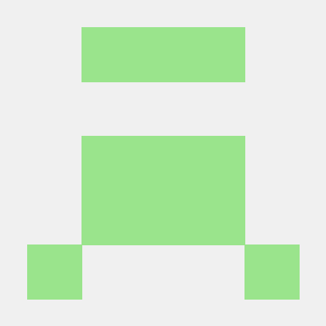
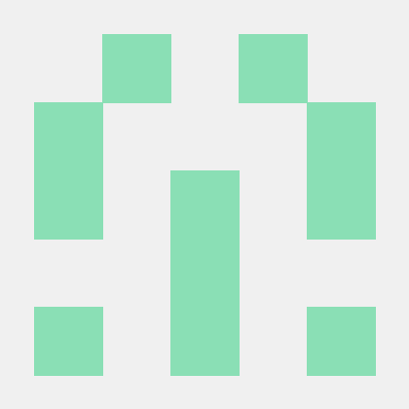
汇报分工
余磊
李维晟
Research
Feasibility
汪若辰
刘云飞
Planning
Progress

Slide 3
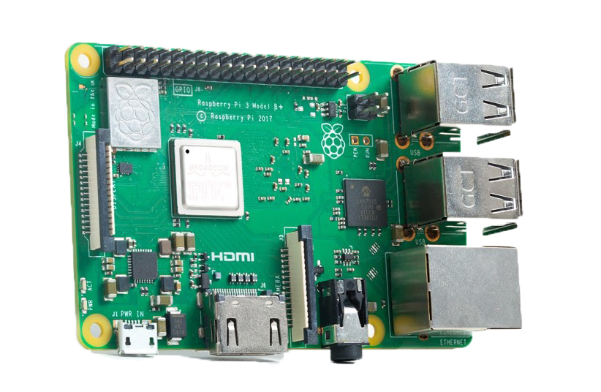

Part 1 Research

Slide 4
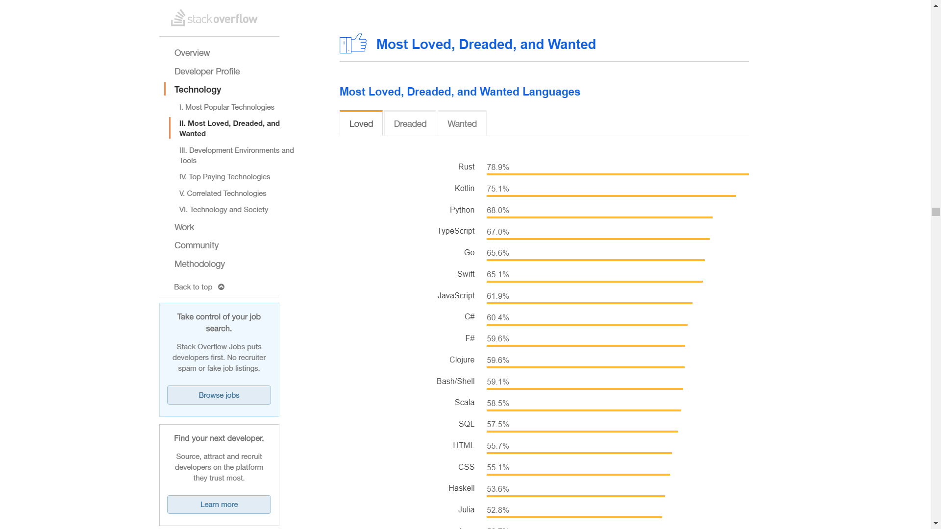

Slide 5
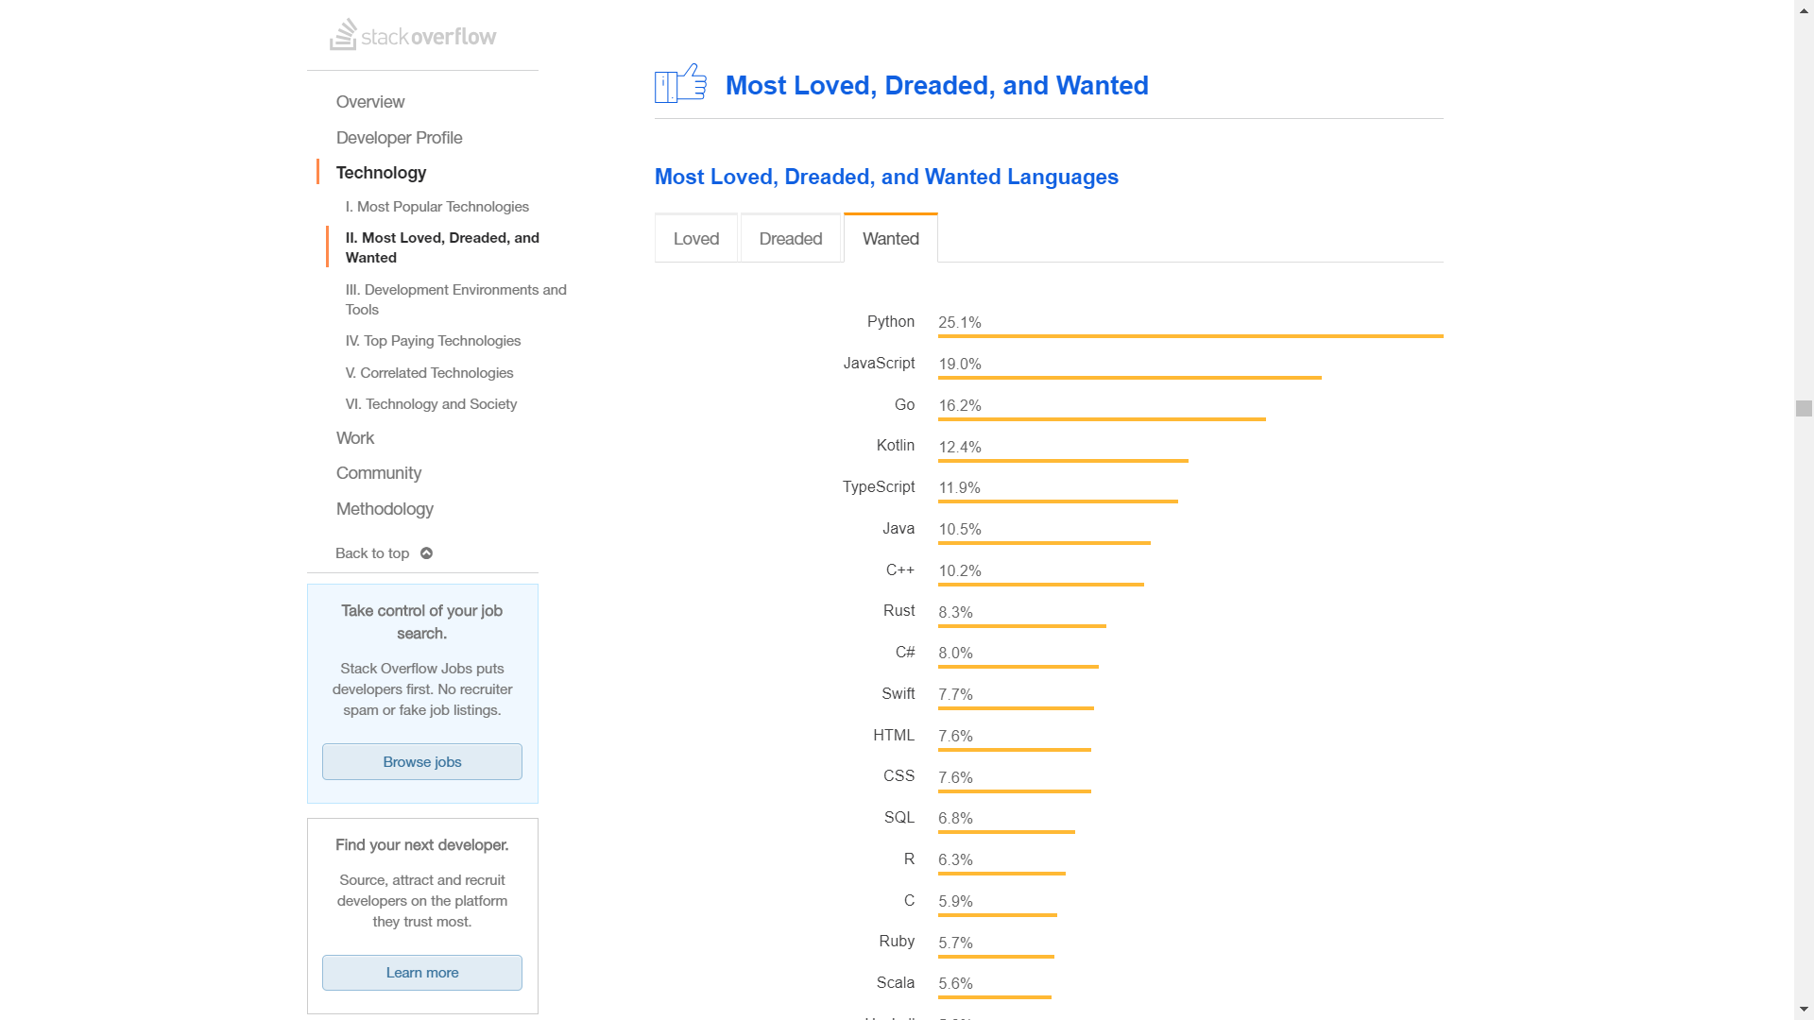

Slide 6
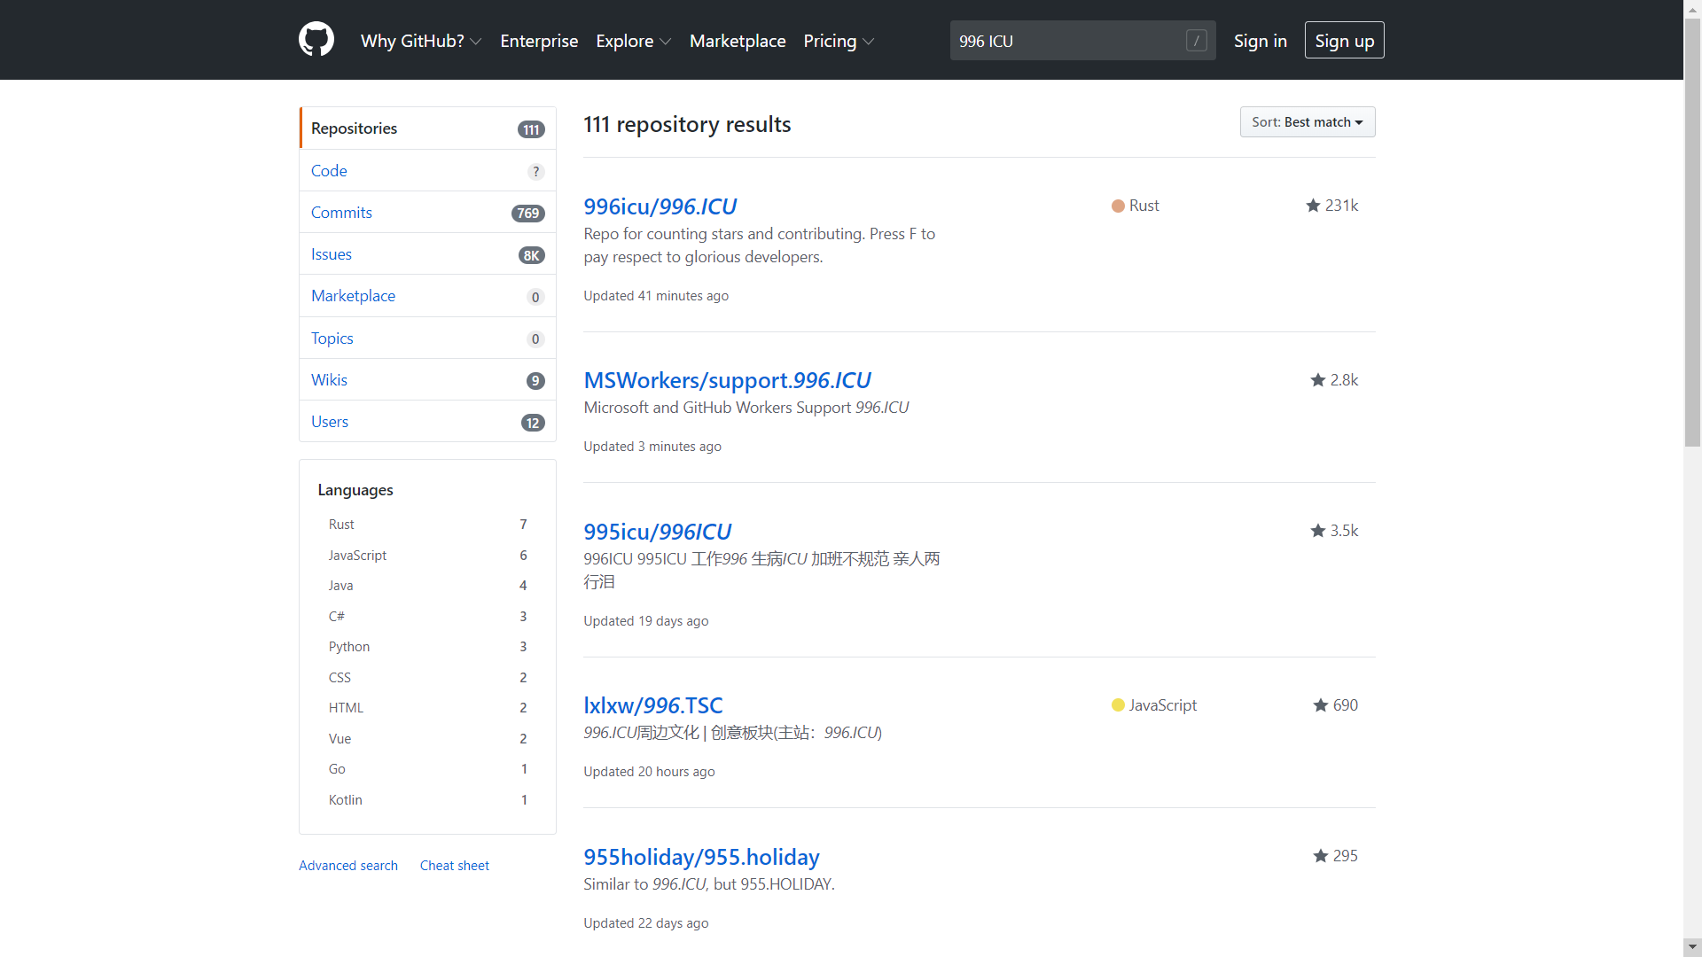

Slide 7
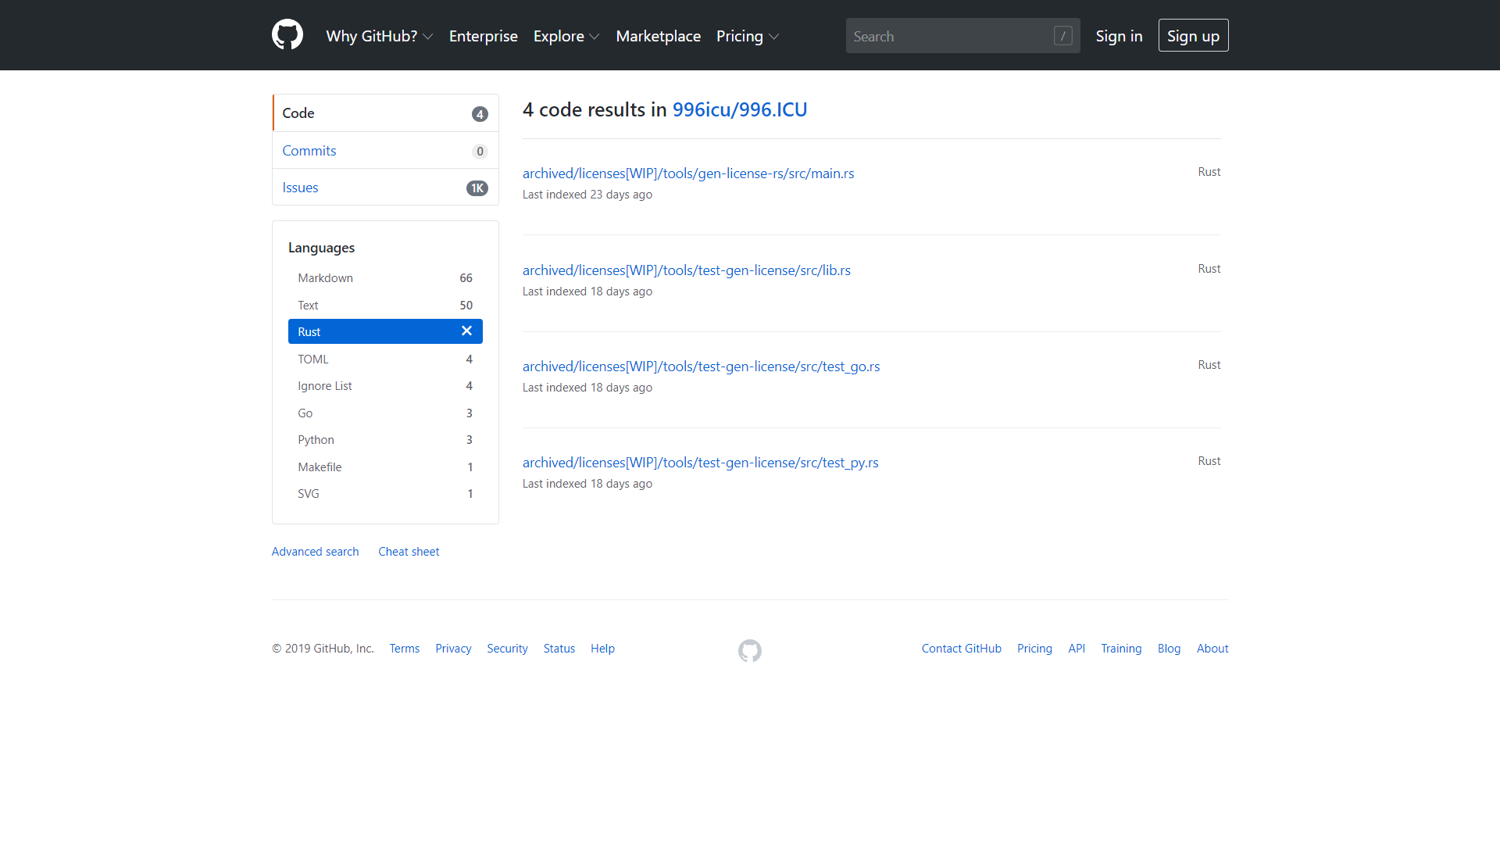

Slide 8


Orbital

Slide 9
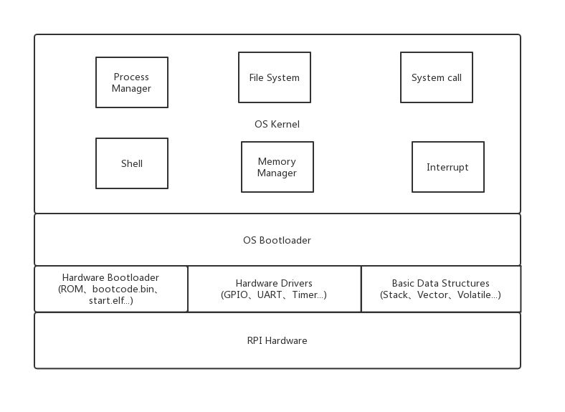
Part 2 Feasibility

Slide 10
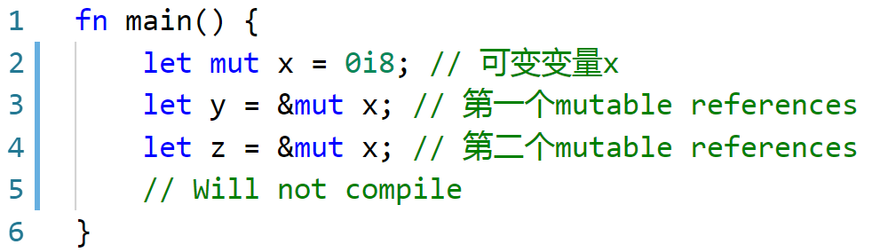
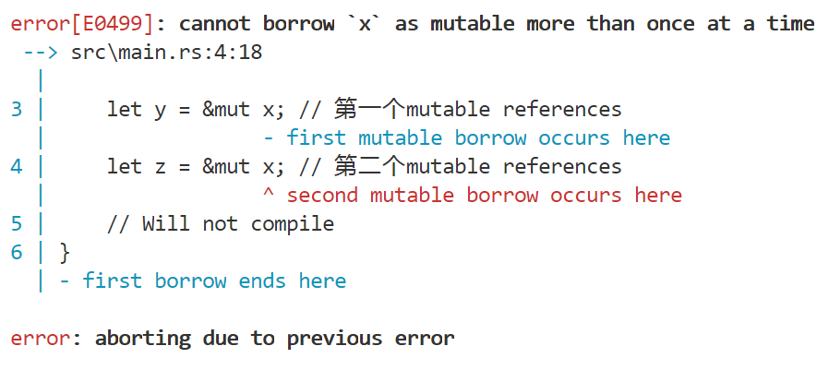
Rust 如何避免数据竞争
Borrowing Rules
a.
b.
Data Race Conditions
a.
b.
c.

Slide 11
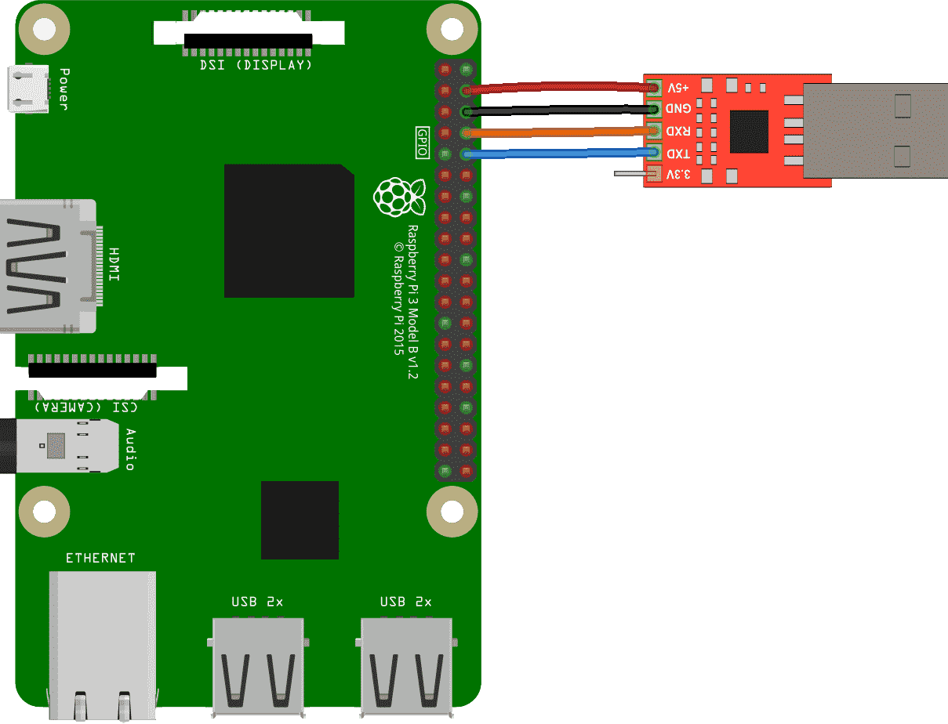
Part 3 Planning
CS140e
Further …
Notes:
计划先跟着 cs140e 做完
优化; 接 HDMI, 键盘 ......
USB 转 TTL 使用 screen

Slide 12
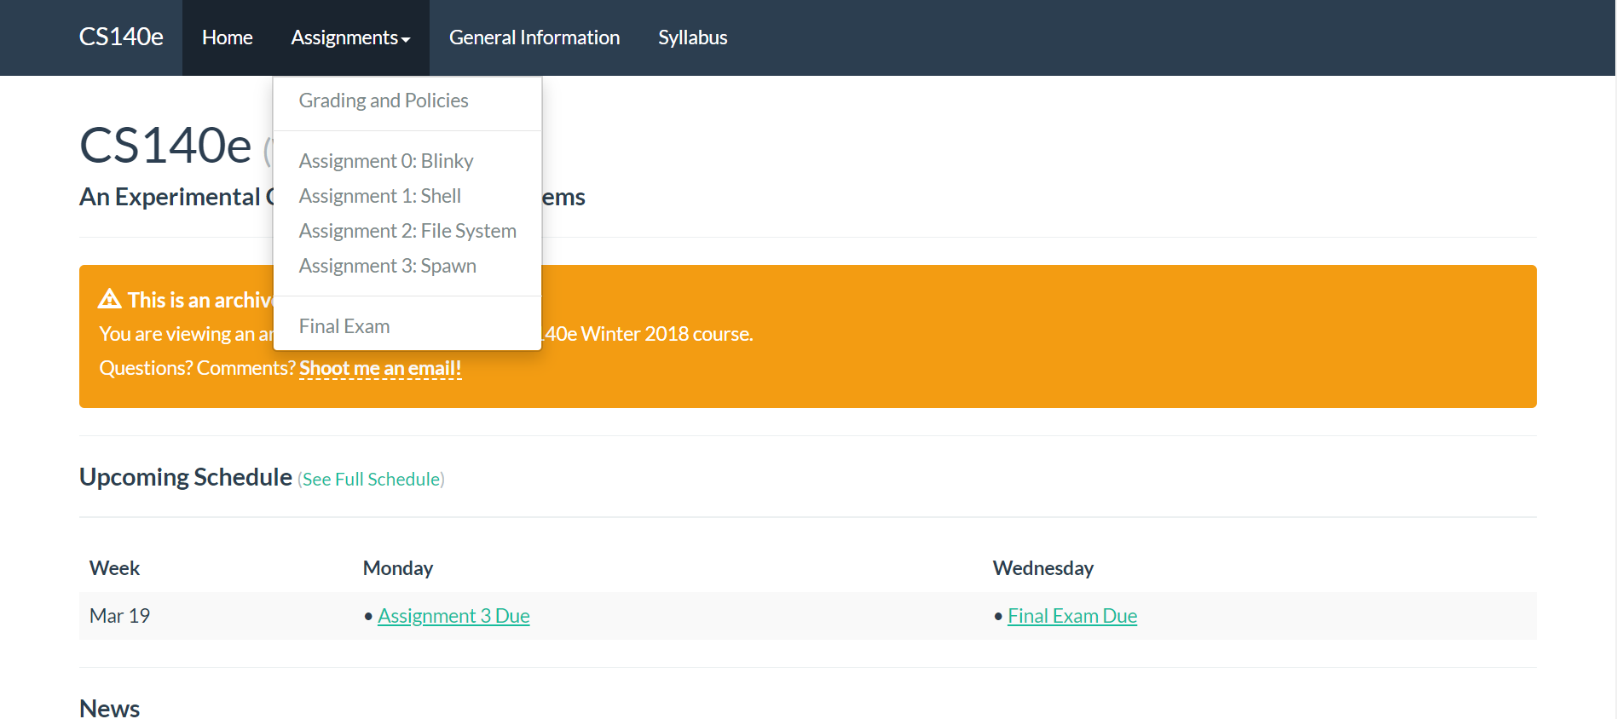
CS140e @ https://cs140e.sergio.bz/
Notes:
0. blinky: 闪灯实验, 熟悉环境
1. shell: 一些工具, 库, 一个 shell (正在做)
2. fs: 内存分配器, FAT32 文件系统
3. spawn: 进程相关

Slide 13
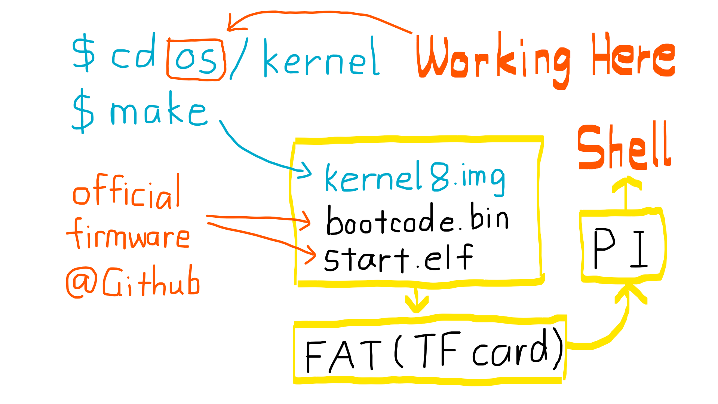
Notes:
https://www.raspberrypi.org/documentation/configuration/config-txt/boot.md
kernel7.img 可用在 Pi 2, Pi 3 上, 如果 Pi 3 上有 kernel8.img, 就会加载 kernel8.img

Slide 14
Part 4 Progress
Assignment 0: Blinky
Assignment 1: Shell
Assignment 2: File System
Assignment 3: Spawn
Further …

Slide 15
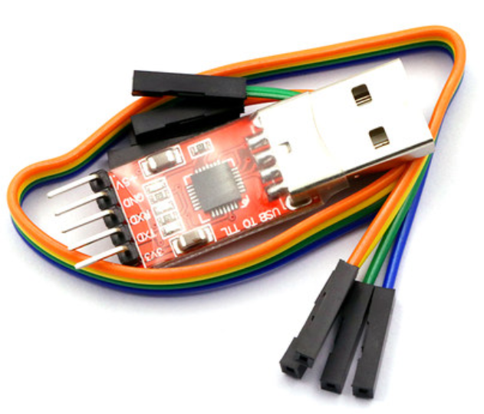
Assignment 0: Blinky
Use USB TTL adapter to communicate with Raspberry Pi.

Slide 16
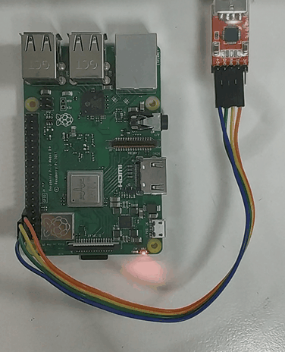
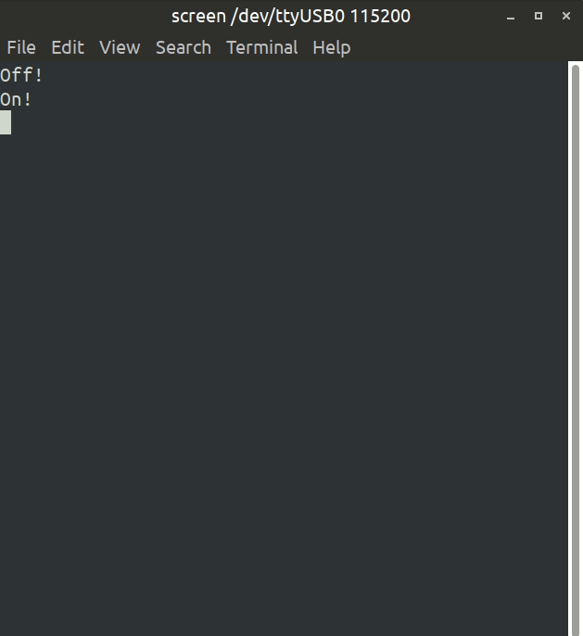
$ sudo screen /dev/ttyUSB0 115200

Slide 17

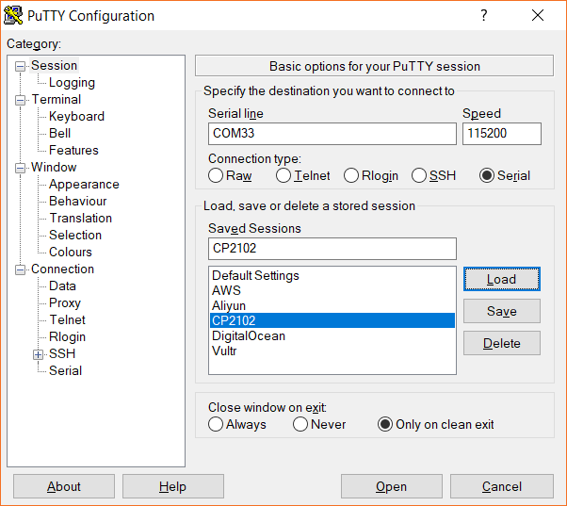
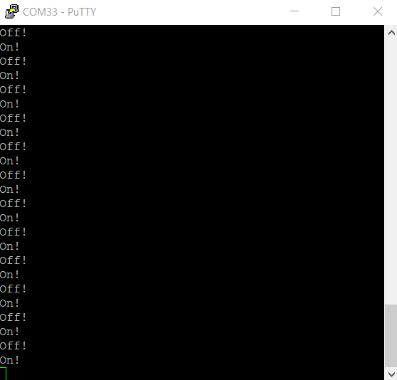
putty.exe COMXX 115200bps

Slide 18

Assignment 1: Shell
StackVec
volatile
xmodem
ttywrite
Timer
GPIO
UART
Shell

Slide 19
Basic structure and interface
StackVec
Volatile type (R, W, R/W, unique)

Slide 20
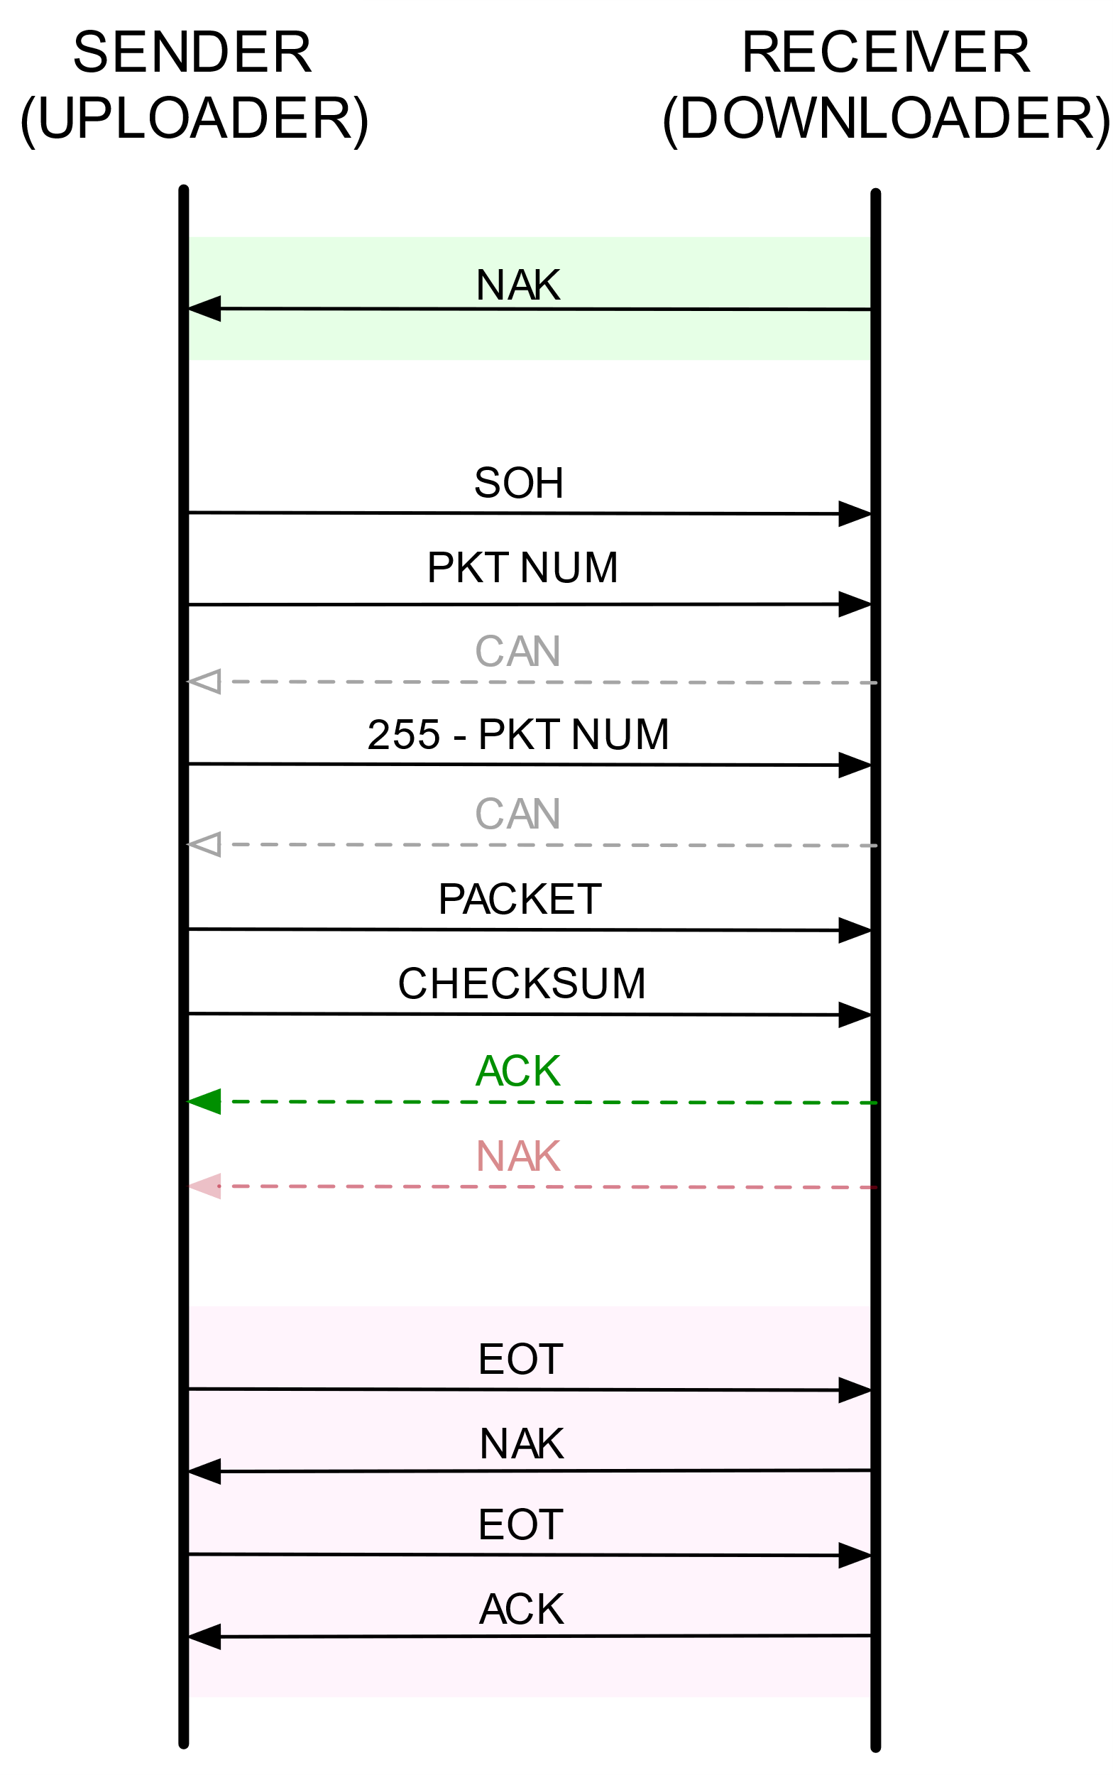
Transmission Method
XMODEM protocol
ttywrite (teletypewriter)

Slide 21
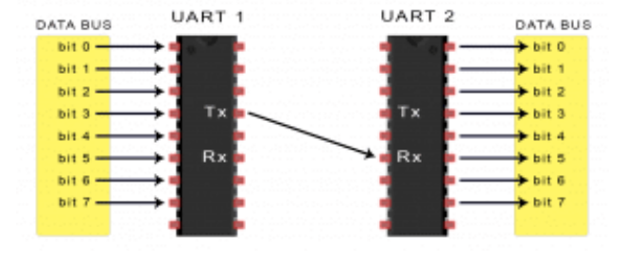
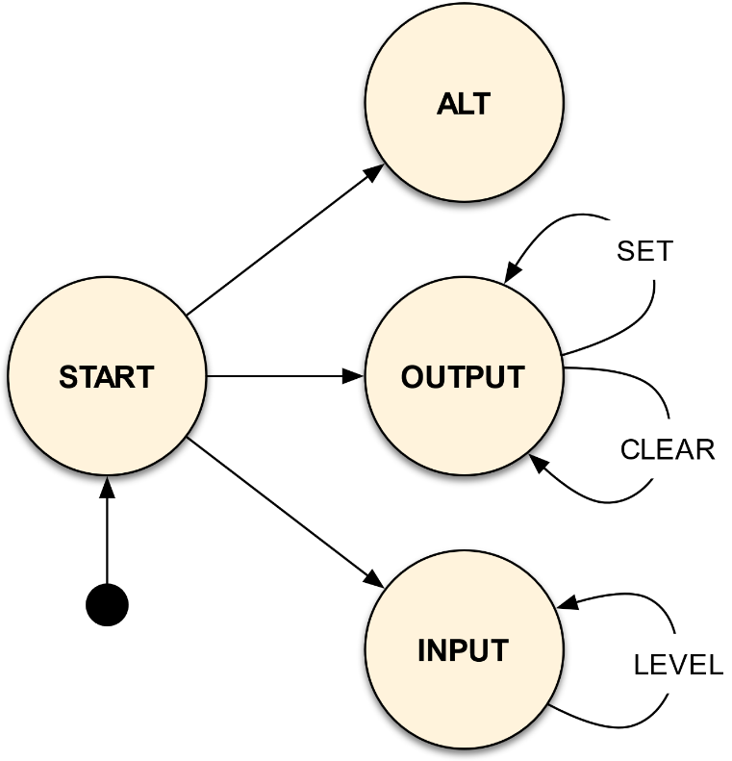
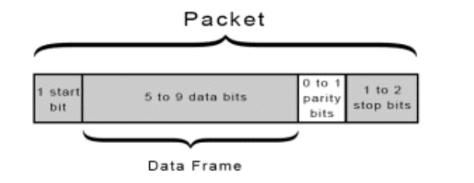
Device Driver
Timer
GPIO
UART

Slide 22
Console and Shell
Coming soon!

Slide 23
Implementing an OS for Raspberry Pi 3 in Rust
Thank You!
刘云飞 李维晟 汪若辰 余磊

